Slide 1
Cashflow Tracker
An AI-Native Personal FinTech Platform
Probabilistic reasoning understands the question — deterministic tools guarantee the numbers.
Plaid · Gmail · Amazon · Costco
Hand-rolled agent (Claude)
2FA web app · eval harness
MCP server · live on Railway
Manjunath Bangalore · github.com/manjax1/cashflow-tracker · live: cashflow.tikitansy.com

Slide 2
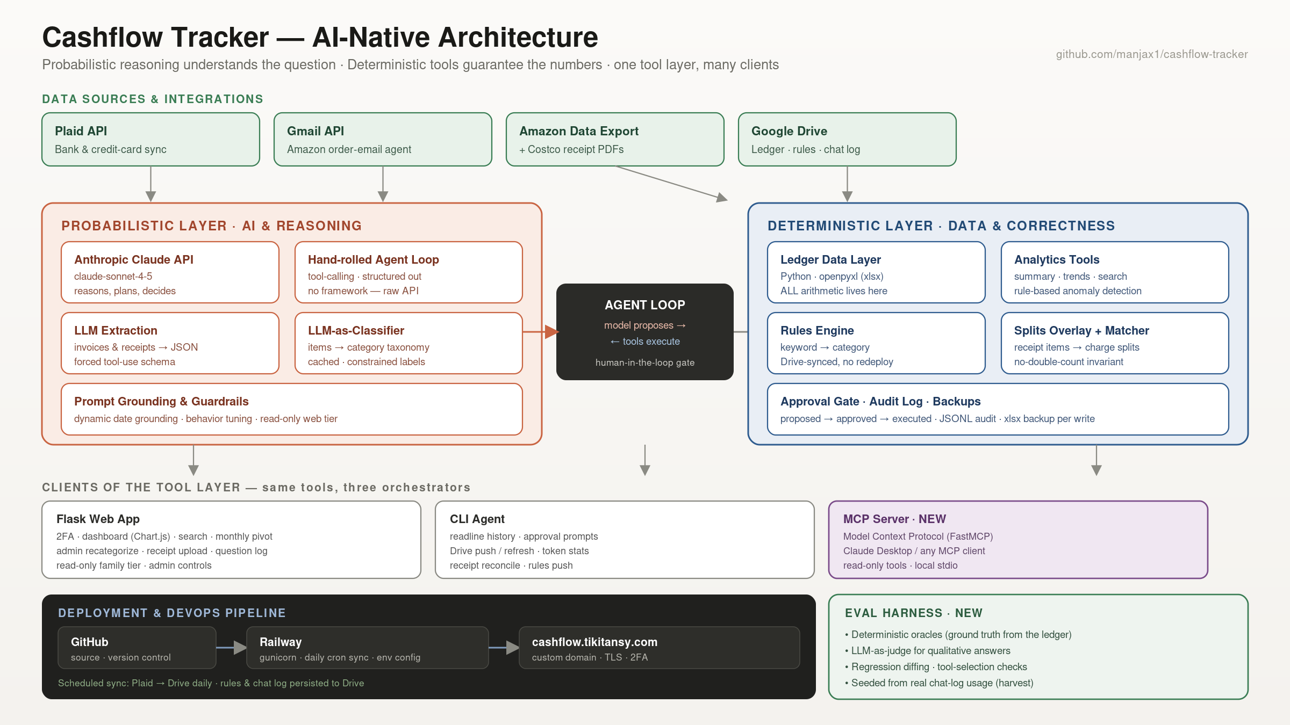

Slide 3
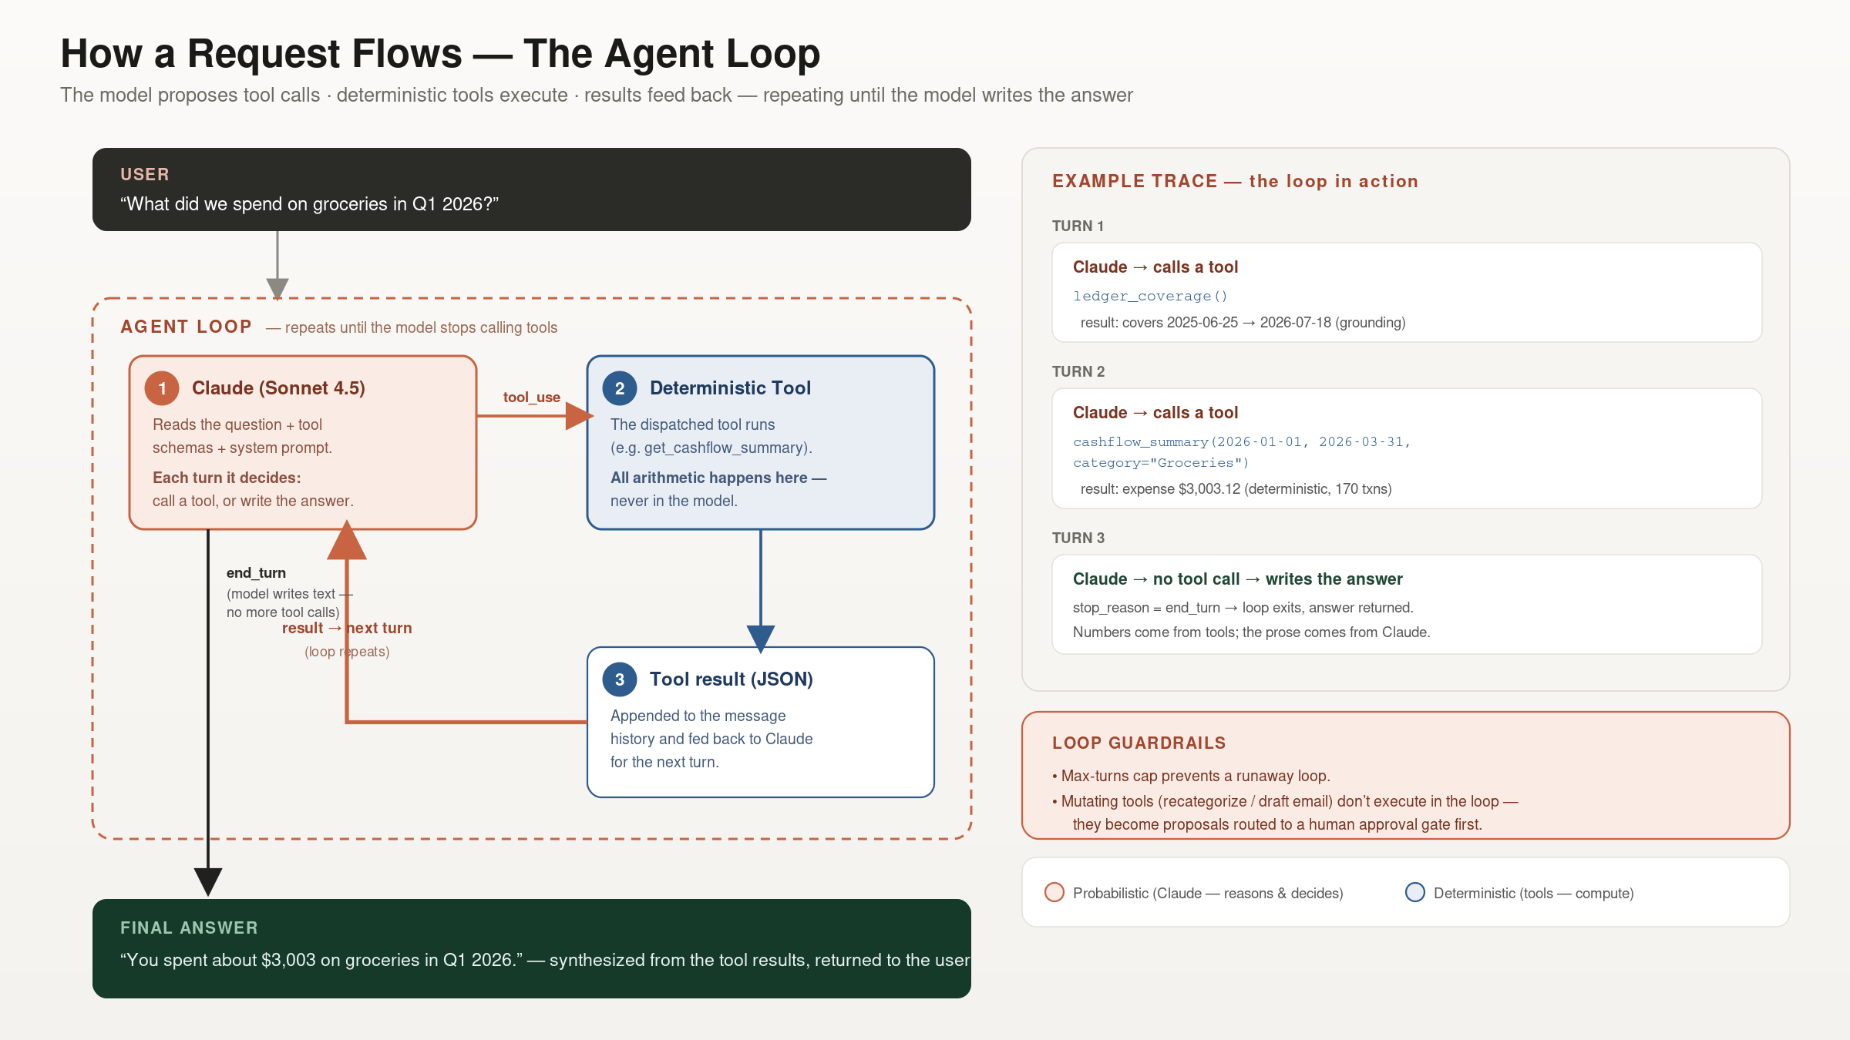
Notes:
The agent loop — talking points: • A user question enters the loop; each turn, Claude decides to either call a tool or write the answer. • If it calls a tool (stop_reason = tool_use), a DETERMINISTIC tool runs — all arithmetic happens there, never in the model — and the JSON result is appended to the message history and fed back. That's the loop. • The loop repeats until Claude returns text (stop_reason = end_turn), at which point the answer is synthesized from the tool results and returned. Numbers come from tools; prose comes from Claude. • Example trace shown is real: ledger_coverage() for grounding, then cashflow_summary(...) → $3,003.12 groceries in Q1 2026, then the final text turn. • Guardrails: a max-turns cap prevents runaway loops; mutating tools (recategorize/draft) never execute inside the loop — they become proposals routed to a human approval gate first. • This ~40-line loop is the whole 'agent' — everything a framework would add is elaboration of it.

Slide 4
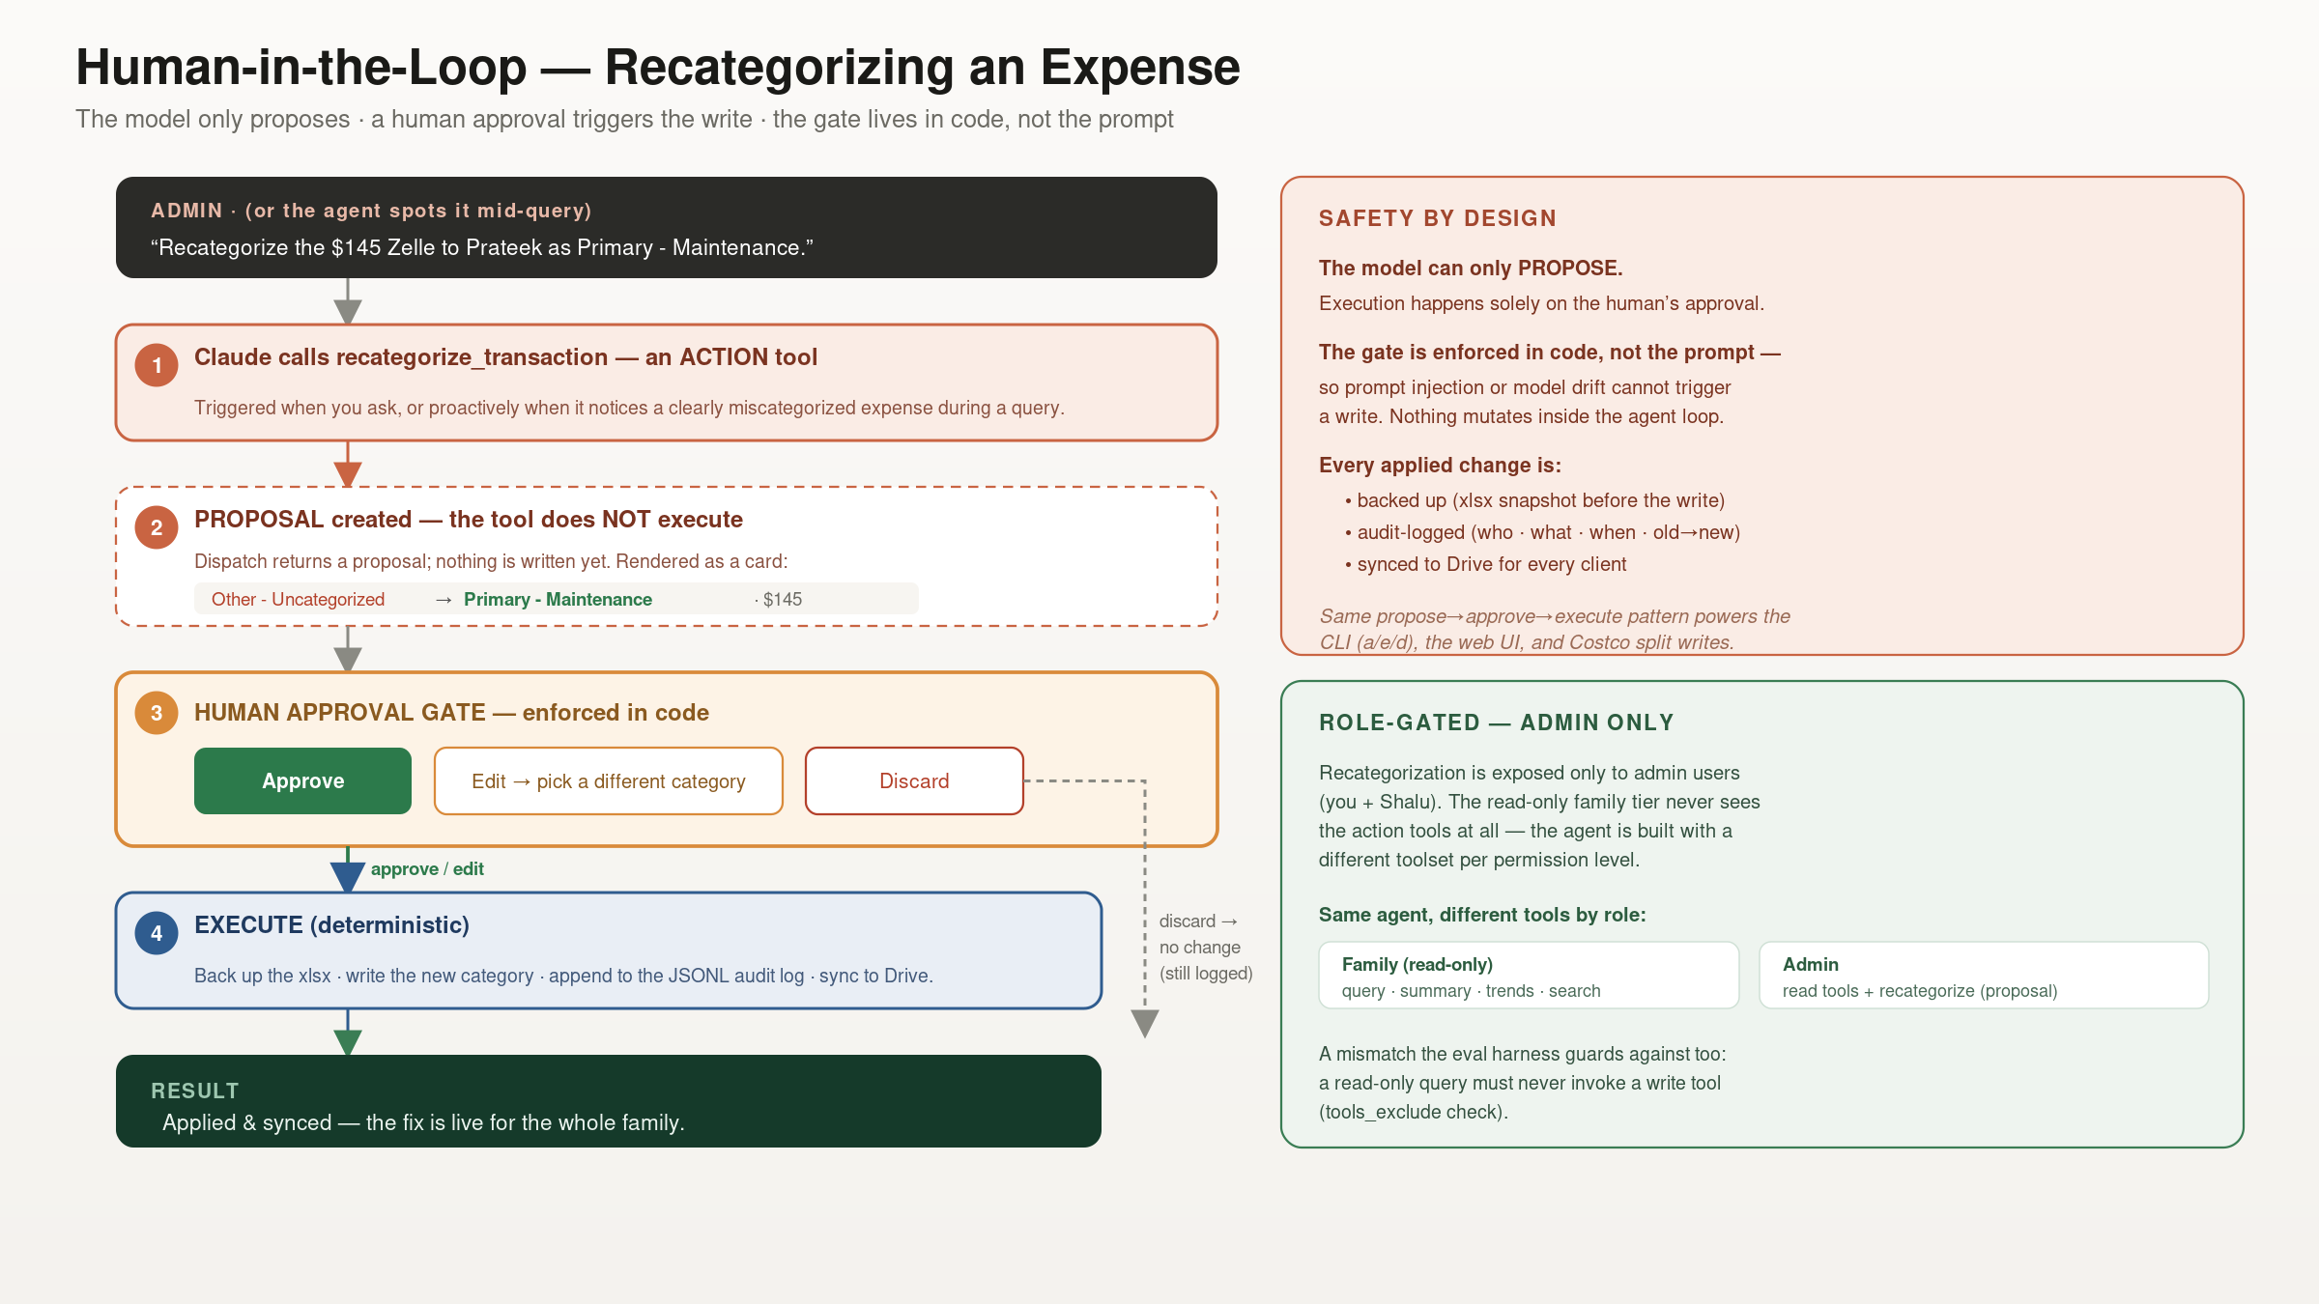
Notes:
Human-in-the-loop recategorization — talking points: • When you ask (or the agent spots a clear miscategorization mid-query), Claude calls recategorize_transaction — an ACTION tool. • Action tools DON'T execute in the loop: dispatch returns a proposal (old→new category), rendered as an Apply/Edit/Discard card. Nothing is written yet. • Only the human's Approve (or Edit-then-approve) triggers EXECUTE: xlsx backup → write category → audit log → Drive sync. Discard leaves the ledger untouched (still logged). • The gate is enforced in CODE, not the prompt — so prompt injection or model drift can't cause a write. This is the same propose→approve→execute pattern used by the CLI (a/e/d), web UI, and Costco split writes. • Role-gated: recategorization is admin-only; the read-only family tier is built with a different toolset and never sees action tools. The eval harness even has a tools_exclude check asserting a read query never calls a write tool.

Slide 5
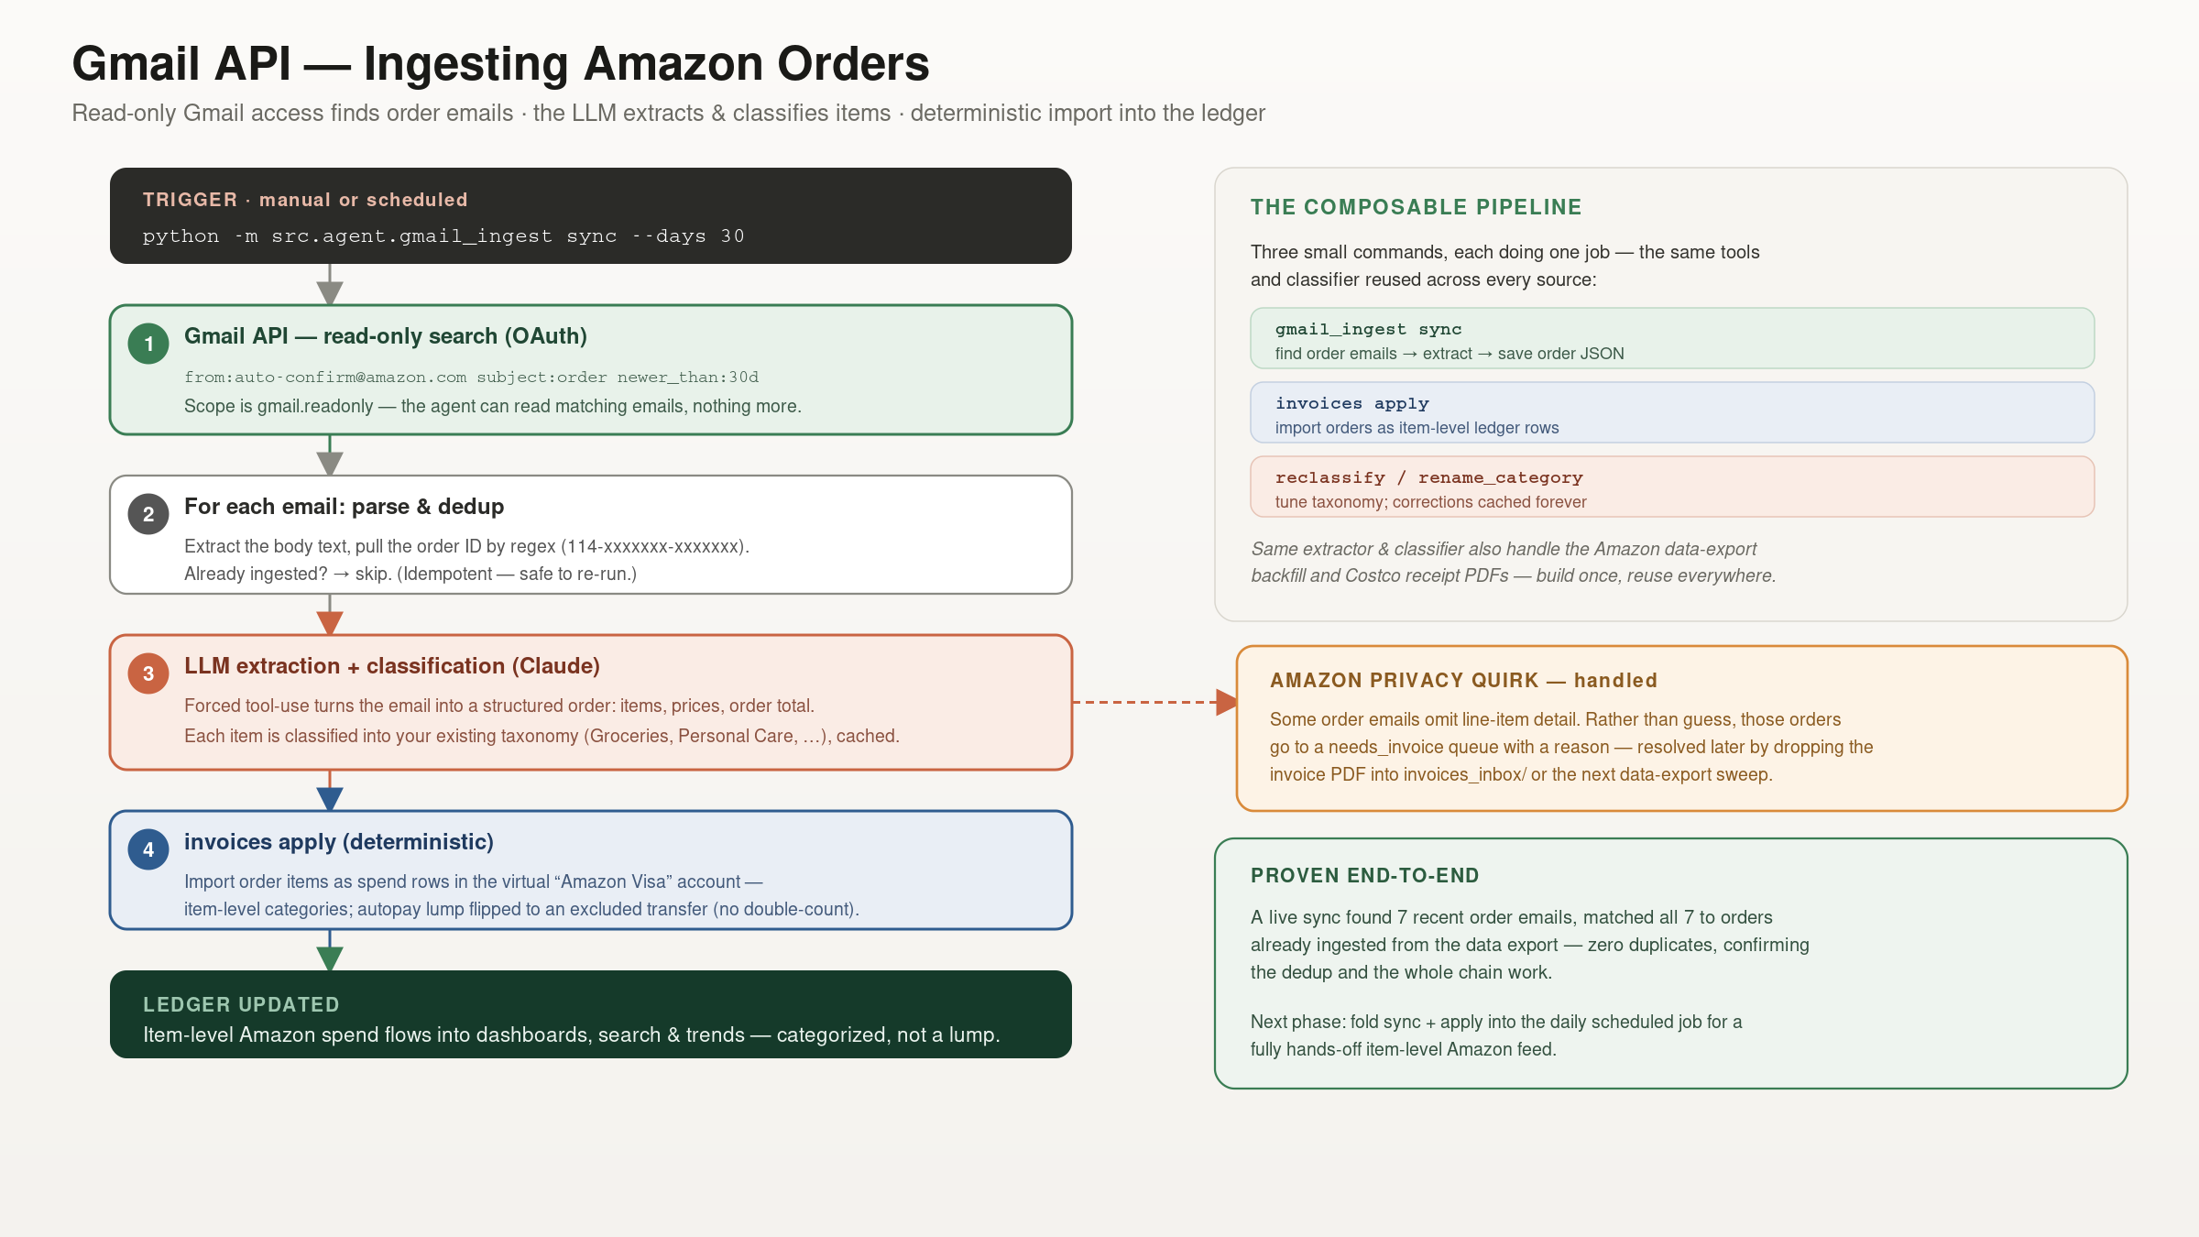
Notes:
Gmail → Amazon ingestion — talking points: • A manual or scheduled trigger runs gmail_ingest sync. It searches Gmail (read-only OAuth scope) for Amazon order-confirmation emails. • For each email: extract text, pull the order ID by regex, and dedup against already-ingested orders — idempotent, safe to re-run. • Claude extracts a structured order (items, prices) via forced tool-use and classifies each item into the existing taxonomy, cached. • invoices apply imports the items as spend rows in a virtual 'Amazon Visa' account with item-level categories, flipping the autopay lump to an excluded transfer so nothing double-counts. • Amazon privacy quirk handled: emails that omit item detail go to a needs_invoice queue rather than producing garbage — resolved later by a PDF or the data export. • Proven: a live sync found 7 order emails and matched all 7 to already-ingested orders — zero duplicates. Same extractor/classifier also power the data-export backfill and Costco receipts.

Slide 6
Architecture — How It Works
Two-layer separation. The LLM reasons and plans; deterministic Python does every calculation. The model is never trusted with arithmetic — eliminating a whole class of hallucinated-number errors.
Hand-rolled agent loop. A raw tool-calling loop over the Messages API, deliberately without an orchestration framework, so the control flow stays transparent and debuggable.
Structured extraction. Forced tool-use turns invoices and receipts into typed JSON; an LLM-as-classifier maps items to a fixed taxonomy, cached for cost control.
Human-in-the-loop. Every state change is proposed → approved → executed, with a JSONL audit trail and automatic backups. Safety is enforced in code, not in the prompt.
Unified ingestion + splits. Plaid, Gmail, data exports and receipt PDFs normalize into one ledger; a non-destructive Splits overlay adds item-level attribution with a proven no-double-count invariant.
Production deployment. A 2FA Flask app on Railway behind a custom domain, self-refreshing from Google Drive; GitHub source; a scheduled daily job keeps data fresh; rules & chat log synced via Drive.
Tested with an eval harness. Deterministic oracles compute ground truth from the ledger; an LLM-as-judge grades qualitative answers against those facts; runs regression-diff and are seeded from real usage.
Interoperable via MCP. The same tool layer is exposed as a Model Context Protocol server — so Claude Desktop and any MCP client drive the ledger, alongside the web and CLI agents.
DEEP-DIVE REFERENCES
Agent design pattern
Anthropic — Building Effective Agents
anthropic.com/research/building-effective-agents
Tool use & structured outputs
Claude Developer Docs
docs.anthropic.com
Interoperability (shipped)
Model Context Protocol
modelcontextprotocol.io
Bank & card data
Plaid API
plaid.com/docs
Email ingestion
Gmail API
developers.google.com/gmail/api

Slide 7
Evolution & Roadmap
From a hand-rolled agent to an MCP-exposed platform
SHIPPED
1
Agent v1
2
Web Platform
3
Invoice Intel
4
Evals
5
MCP Server
Hand-rolled tool-calling loop; deterministic tools; human-in-the-loop gate; CLI.
Chat, dashboard, search; 2FA multi-user; Railway + custom domain; Drive-synced.
Amazon (export + Gmail agent) & Costco receipt splits; item-level, no-double-count.
Deterministic oracles + LLM-as-judge; regression; seeded from real usage.
Tool layer exposed via Model Context Protocol; Claude Desktop & any MCP client.
ON THE ROADMAP
6
RAG + Multi-Agent
ONE TOOL LAYER, MANY CLIENTS
Retrieval-grounded document Q&A over leases, policies & statements with cited sources; a multi-agent research and analysis pipeline layered on the existing tools.
The same deterministic tools now serve three orchestrators — the CLI agent, the 2FA web app, and Claude Desktop via MCP — plus the eval harness that tests them. Clean tool/agent separation is what made each new client nearly free.
Five phases shipped, each deepening a distinct agentic-AI skill: the agent loop · deployment & auth · document intelligence · evaluation · interoperability.

Slide 8
AI Engineering — Techniques & Lessons
“The probabilistic layer understands intent; the deterministic layer guarantees correctness.”
TECHNIQUES APPLIED
ENGINEERING LESSONS
Agentic tool-use loop over the raw API (no framework)
Structured outputs via forced tool-use
LLM-as-classifier, constrained to a fixed taxonomy
Document / multimodal extraction (PDF & email)
Human-in-the-loop guardrails on every mutation
Evaluation: deterministic oracles + LLM-as-judge
MCP interoperability (one tool layer, many clients)
Separate probabilistic reasoning from deterministic correctness
Enforce safety in code, not in prompts
Debug real failure modes: grounding, over-caution, misinference, silent false-negatives
Make tool inputs forgiving so plausible model guesses succeed
Ship, deploy, and measure — build to learn

